Slide 1

Network of Hope
Bachelors Degree Assessment, Progression & Classification
July 2021

Slide 2
Completion of your Award
If you are a combined honours student you must achieve 40%+ in both Subjects.
You must not have any mark associated with non submission, nor must you have a mark of 0 associated with academic misconduct;
You must achieve a minimum of a Grade E in all qualifying components;
PSRB requirements must be met if appropriate.

Slide 3
Classification:
How do my marks relate to degree classes?
  Your marks and grades for individual assessments relate to degree classes as shown opposite.
  If all your marks fall in the same class band, that is what you will get!
  However, most students aren’t quite so consistent…….
A+ or A | 70-100 | First class Honours [1st]
B or B+ | 60-69 | Upper Second Class Honours [2i]
C or C+ | 50-59 | Lower Second Class Honours [2ii]
E or D | 40-49 | Third class Honours [3rd]

Slide 4
Level C is included in your degree calculation
You should be aware that Level C (your first year) is an important part of your studies
  It will be included in your degree calculation;
  It is a pivotal platform on which to build excellent academic achievement at the higher levels of study.

Slide 5
How will my degree class be calculated?
Determining your Overall Aggregate
Two methods are used
  Method 1:
    10% of Level C; 30% of Level I; 60% of Level H
  Method 2:
    25% Level I; 75% Level H.

Slide 6
How will my degree class be calculated?
How we calculate your Overall Aggregate mark in TWO ways
Procedure
Method 1: 10:30:60
(Level C mark x 10% ) + (Level I mark x 30%) + (Level H mark x 60%).
Method 2: 25:75
(Level I mark x 25%) + (Level H mark x 75%).
Example
A student’s marks are: Level C 55; Level I 62; Level H 75.
Method 1: (55x10%) + (62x30%) + (75x60%) = 5.5 + 18.6 + 45 = 69.1.
Method 2: (62x25%) + (75x75%) = 15.5 + 56.3 = 71.8.

Slide 7
How will my degree class be calculated?
Borderline cases
If your overall highest aggregate falls within 2 rounded marks of the next grade boundary we will consider you to be a borderline student.
We will look at your transcript and check whether 50% of your Level H marks are in the higher classification – we can only include first attempts.
If 50% of your assessments are in the higher band you will achieve the higher of the degree outcomes.
Note:
  The Board will focus ONLY on the quality of your work.
  The Board will NOT take into account any mitigating circumstances.

Slide 8
Fit To Sit
If you aren’t fit to do a Level H assessment.. DO NOT ATTEMPT THE ASSESSMENT
If you miss an assessment and you have evidence of acceptable mitigating circumstances [not necessarily ”medical”], you will normally be entitled to undertake the assessment later with no penalty.
By submitting any assessment you are deeming yourself fit to be assessed.
Therefore, it is essential to:
  submit evidence of mitigating circumstances to explain absence from an exam;
  seek an extension if you are not able, for good reasons, to submit work on time.

Slide 9
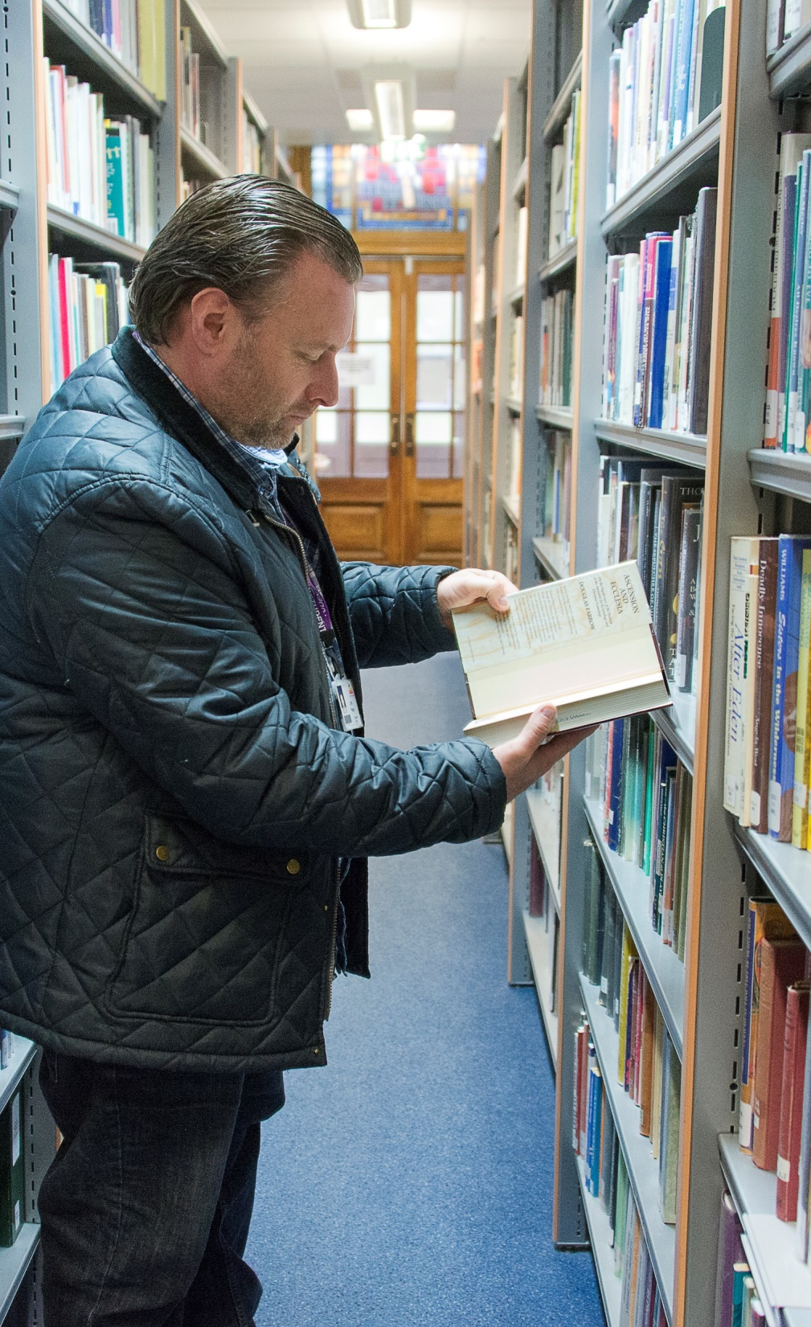
Progressing from Certificate Level to Intermediate Level
A guide for Certificate Level students (Year C)

Slide 10
What must I do to progress to Intermediate Level?
This guidance applies to all Network of Hope Students in year C (first year) of their undergraduate degree
  You must achieve an overall weighted aggregate of 40%+ for your Level of Study
  You will not be able to progress even with an aggregate of 40%+ if:
    Your profile includes any mark of 0 associated with non-submission or academic misconduct.
    You have failed to reach a minimum of Grade E for any academic assessment that the University has defined as a “Qualifying Component”.
    You do not meet Professional or Statutory Regulatory Body (PSRB) requirements.

Slide 11
Where do I find more information?
This information is for Guidance Only.
If you have any queries, please contact The Registry Office and ask for an appointment to talk to a Senior Academic Adviser.
Please seek advice immediately if you think you have mitigating circumstances.

Slide 12
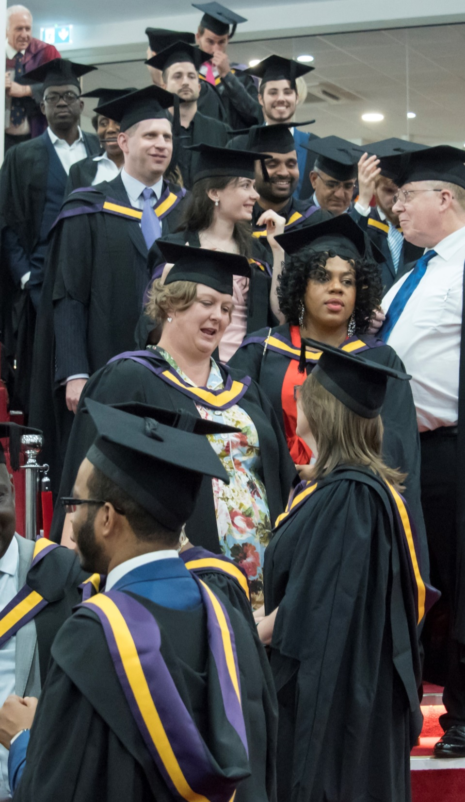
Progressing from Intermediate Level to Honours Level
A guide for Intermediate Level students (Year I)

Slide 13
What must I do to progress to Honours Level?
This guidance applies to all Network of Hope Students in year I (second year) of their undergraduate degree
  You must achieve an overall weighted aggregate of 40%+ for both of your Subjects
  You will not be able to progress even with an aggregate of 40%+ if:
    Your profile includes any mark of 0 associated with non-submission or academic misconduct.
    You have failed to reach a minimum of Grade E for any academic assessment that the University has defined as a “Qualifying Component”.
    You do not meet Professional or Statutory Regulatory Body (PSRB) requirements.

Slide 14
What must I do to progress to Honours Level?
As your course is a Joint Honours degree
If you achieve 40%+ in one Subject, but achieve 35-39% in your other Subject you may apply to change to Single Honours in the Subject you did pass.
If you are successful in moving to Combined Honours you will be considered to have a Pass with Reservation in the Subject you are leaving at Level I.

Slide 15
Where do I find more information?
This information is for Guidance Only.
If you have any queries, please contact The Registry Office and ask for an appointment to talk to a Senior Academic Adviser.
Please seek advice immediately if you think you have mitigating circumstances.

